Slide 1

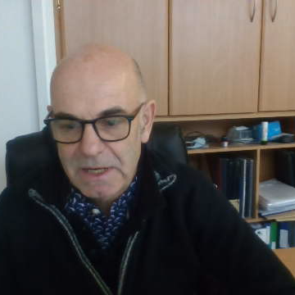

Athboy SEC
Energy Master Plan (EMP)
23rd November 2024
Michael Hanratty, Keer Xu & Jose Ramirez
IHER Energy Services Ltd.
michael@iher.ie

Slide 2
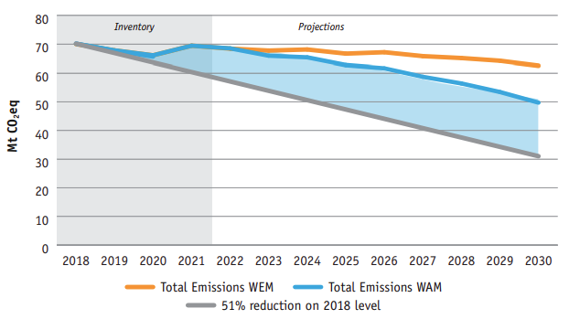

Total Greenhouse Gas Emissions With Existing Measures (WEM) and With Additional Measures (WAM) scenarios out to the year 2030
Ireland’s Climate Action Plan set target of 51% reduction in Greenhouse Gas Emissions by 2030 from 2018 baseline
Gap exists between (With Additional Measures scenario) projections and the 51% target. Source: Ireland’s greenhouse gas emissions projections 2022-2040 (EPA, 2023)
Notes:
https://www.epa.ie/publications/monitoring--assessment/climate-change/air-emissions/EPA-GHG-Projections-2022-2040_Finalv2.pdf
Land Use, Land Use Change and Forestry (LULUCF)
With Existing Measures (WEM)
The WEM scenario is a projection of future emissions based on the measures currently implemented and actions committed to by Government. To become part of the WEM scenario a policy or measure must be in place by the end of 2021 (the latest inventory year) and the projected emissions reduction is commensurate with the resources or legislation already in place or committed to Government Departments or Agencies. For example, the WEM scenario includes a measure where the Carbon tax increases annually and reaches €100 per tonne by 2030. This policy is considered to be implemented because annual carbon tax increases have been committed to in legislation (Finance Act 202015).
With Additional Measures (WAM)
The WAM scenario is the projection of future emissions based on the measures outlined in the latest Government plans at the time Projections are compiled. This includes all policies and measures included in the WEM scenario, plus those included in Government plans but not yet implemented. For example, the WAM scenario includes the target of 945,000 Electric Vehicles on the road by 2030 in the Climate Action Plan 2023. The full amount of this ambition is not currently in the With Existing Measures scenario as actions still remain to be taken that would deliver it. nual carbon tax increases have been committed to in legislation (Finance Act 202015).

Slide 3
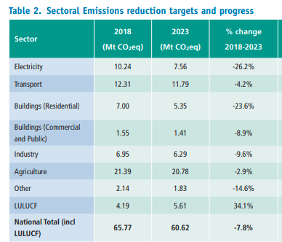
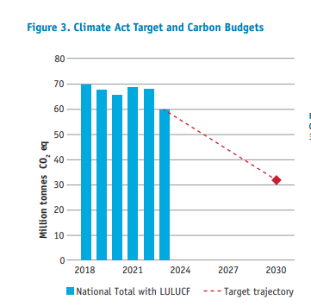
Progress from 2018 - 2023
By end of 2023, a 7.8% reduction had been achieved from the 2018 baseline.
So, a big gap must be bridged by 2030.
(Source: EPA-Provisional GHG Report-July 2024)
LULUCF: land use, land use change, and forestry
Notes:
https://www.epa.ie/publications/monitoring--assessment/climate-change/air-emissions/EPA-GHG-Projections-2022-2040_Finalv2.pdf
Land Use, Land Use Change and Forestry (LULUCF)
With Existing Measures (WEM)
The WEM scenario is a projection of future emissions based on the measures currently implemented and actions committed to by Government. To become part of the WEM scenario a policy or measure must be in place by the end of 2021 (the latest inventory year) and the projected emissions reduction is commensurate with the resources or legislation already in place or committed to Government Departments or Agencies. For example, the WEM scenario includes a measure where the Carbon tax increases annually and reaches €100 per tonne by 2030. This policy is considered to be implemented because annual carbon tax increases have been committed to in legislation (Finance Act 202015).
With Additional Measures (WAM)
The WAM scenario is the projection of future emissions based on the measures outlined in the latest Government plans at the time Projections are compiled. This includes all policies and measures included in the WEM scenario, plus those included in Government plans but not yet implemented. For example, the WAM scenario includes the target of 945,000 Electric Vehicles on the road by 2030 in the Climate Action Plan 2023. The full amount of this ambition is not currently in the With Existing Measures scenario as actions still remain to be taken that would deliver it. nual carbon tax increases have been committed to in legislation (Finance Act 202015).

Slide 4
Athboy EMP Study Objective
The Government’s Climate Action Plan (2024) CAP 2024 re-establishes the target to achieve a 51% reduction in (GHG) emissions by 2030 from the 2018 baseline.
Athboy EMP presents a local energy model and local emissions reduction target & plan.
Baseline Study
current energy demand across residential, commercial, public buildings and transport
Energy Audits
2 public buildings and 5 house types
2030 EMP
Targets and Roadmap

Slide 5
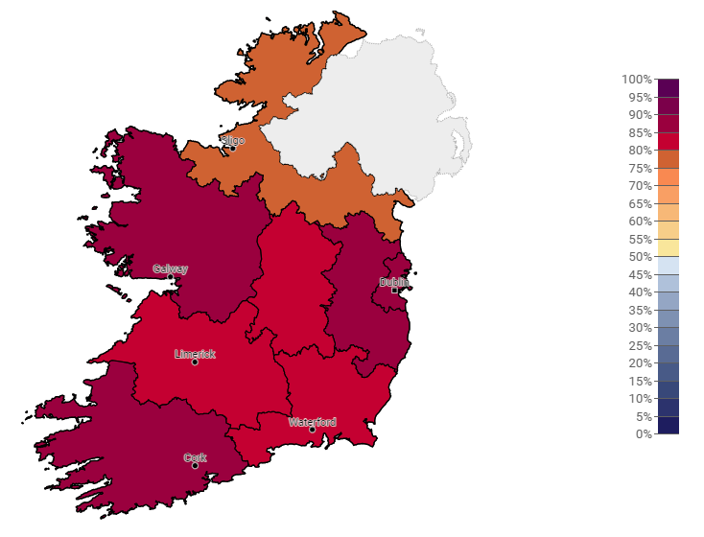
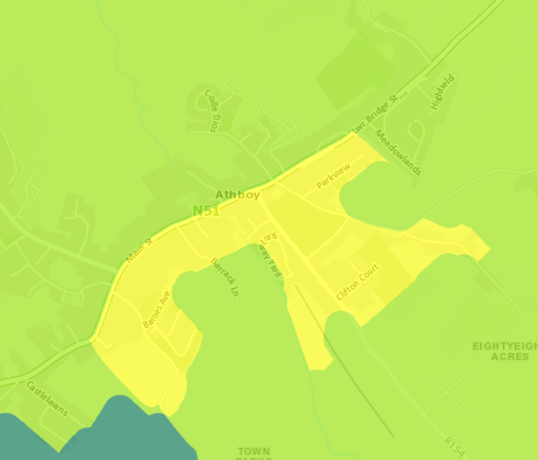
Residential Emissions
Athboy
1965 dwellings & 36% (707) have BERs
Over half are built from 1994 onwards
Average BER is D1
D1
Average
(Climate Opinion Maps, 2023)

Slide 6
Residential Baseline – Total Stock BER Scores

Slide 7

Residential Baseline – Residential Main Heating
Heat Pump
14%
13%
69
Electric Heating
106
Electricity
Solid Fuels
Condensing Boiler
66%
2%
166
Non-Condensing Boiler
366
Heating Oil
LPG
(BER Database, 2023)
(Census, 2022, other 5%)

Slide 8
Residential Baseline – Heat Pump
22 %
15 Heat pumps in before 2010 houses
78 %
69
54 Heat pumps in 2010 onwards houses
Approx. 250 dwellings with BERs are “heat pump ready” (HLI below 2.3).

Slide 9
Residential Baseline Results
Inputs
Outputs
Dwellings
1965
Total Primary Energy
58,526,000 kWh
Average Primary Energy per dwelling
29,787 kWh/annum
CO₂
17,522 tonnes
Analysis
Annual Residential Energy Costs
€ 7,467,000
Annual Energy Bill
€ 3,800

Slide 10
Commercial / Public Buildings Baseline Results
Inputs
Outputs
66 Small businesses
4 Medium businesses
3 energy audits of business premises (Ecological Building Systems,
Darnley Lodge,
Athboy EMTB)
Total Primary Energy
82,166,000 kWh
Analysis
CO₂
24,500 tonnes
Energy bills from audits & SEAI annual estimates
Annual Business Energy Costs
€ 2,150,000

Slide 11
Transport Baseline Results
Inputs
Outputs
Car Split (Dept of Transport- 2022):
741 Petrol
1,168 Diesel
161 BEVs
2,070 Total
Total Primary Energy
23,435,000 kWh
Analysis
CO₂
5,470 tonnes
National Annual Average
12,113 km Petrol
19,681 km Diesel
12,958 km BEVs
Annual Transport Costs
€ 4,700,000
Note: 1000 kg CO2 = 1 Tonne CO2
National statistics based on average distances travelled, kWh/km and gCO₂/km

Slide 12
Athboy Summary Baseline - 2023
Baseline is 47,520 tonnes CO₂ and
164.21 GWh energy per annum in 2023

Slide 13
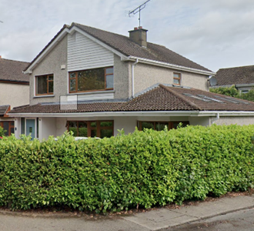
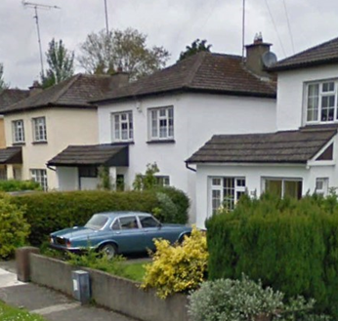
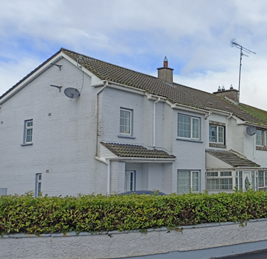

Audits - 5 x Residential Survey & Analysis
Note: Heat loss indicator (HLI) must be <=2* to qualify for SEAI Heat Pump grant
Starter: roof insulation, heating controls
Standard: + external/internal wall insulation, condensing boiler & stove
Advanced: + external/ internal wall insulation, double glazed windows, heat pump, stove, whole house ventilation

Slide 14
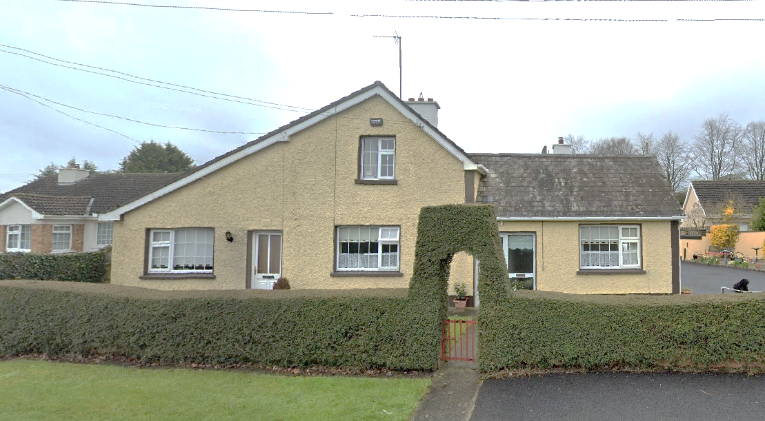
Residential Survey – Otterstown
Concrete block walls
100mm EPS external wall insulation (U=0.27)
300mm attic insulation, sloping roof insulation (U=0.20)
New double glazed low-e windows

Slide 15
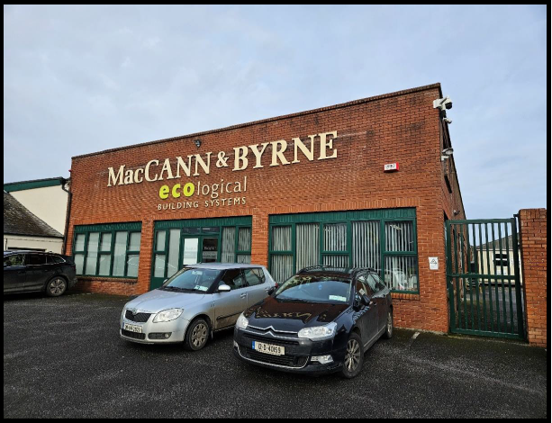
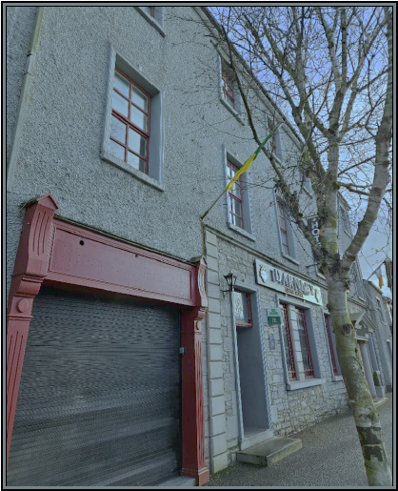
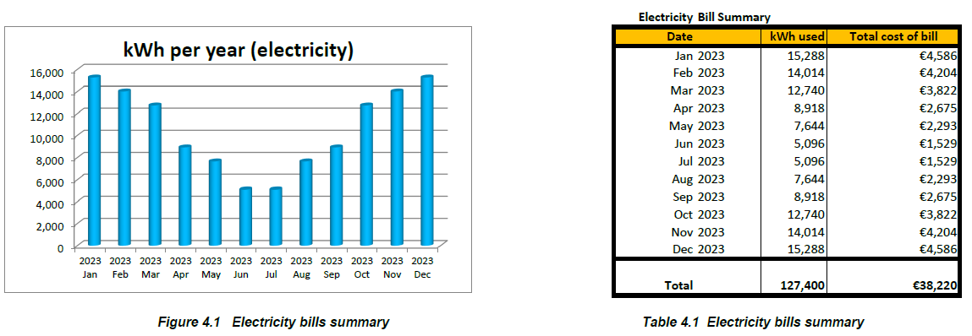
–
Audits – Ecological Building System & Darnley Lodge Hotel

Slide 16

Residential Upgrade Scenario (2024-2028)
A2
  Category 4A- Advanced measures (Standard with heat pump and whole house ventilation) & PV – 75 homes
A3
  Category 4 - Advanced measures (Standard with heat pump and whole house ventilation) – 100 homes
B1
  Category 3A - Standard measures package (roof insulation, internal or external wall insulation, boiler and heating controls , wood stove) & PV – 50 homes
B2
  Category 3 - Standard measures package (roof insulation, internal or external wall insulation, boiler and heating controls , wood stove) – 25 homes
C1
  Category 2A – Roof insulation, heating controls & PV – 25 homes
C2
  Category 1 - PV only– 100 homes
Assumption: 25% of dwellings will be upgraded in next 5 years
C3
  Category 2 - Roof insulation and heating controls – 41 homes

Slide 17
Impact of De-carbonising Electricity in Ireland
CO2 Emission (kg/kWh)
32% all electricity generated in 2019 was from wind and avoided 3.9 million tonnes of CO2 emissions. 4,332.5 MW Installed capacity in Ireland as of May 2022. (SEAI, 2023)

Slide 18
Residential – Energy Reduction Model (2023-2033)
This upgrade plan is equivalent to a 3.85% annual reduction in energy usage.
When accounting for the ongoing decarbonisation of electricity, there will be a 26% reduction by 2028 & 44% by 2033.
-6% -11% -16% - 21% -26% -30% -34% -38% -42% -46%

Slide 19
Non-domestic Buildings Energy Model
3% reduction in Commercial/ Public Building Energy Usage
-3%
-9%
-11%
-14%
-17%
-19%
-22%
-24%
-26%
*** All public buildings and businesses in Athboy need to develop energy and carbon reduction plans

Slide 20
Transport Projections to 2033
Assume 30% EV Market Share by 2030
Athboy 2030 | Petrol | Diesel | Battery EV | Totals
National annual average km | 12,113 | 19,681 | 12,958
kWh per car/annum | 7,516.12 | 11,710.20 | 4,185.43
kg CO2 per car/annum | 1,719 | 2,794 | 716
Total cars split | 580 | 869 | 621 | 2070
kWh -all cars/a | 4,356,341 | 10,180,844 | 2,599,155 | 17,136,339
kg CO2 - all cars/a | 996,588 | 2,428,858 | 444,592 | 3,870,038
3.75% reduction in Car Transport Energy Usage
-3.7% -7.4% -10.8% -14.2% -17.4% -20.5% -23.5% -26.3% -29.1% -31.8%
Notes:
Cannot find this table from the Marino folder

Slide 21
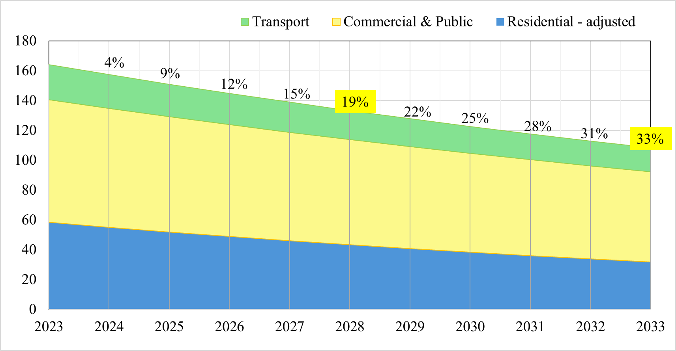
Athboy SEC Energy Reduction Projection – All Sectors (2023-2033)
Athboy EMP - 2033 Energy Reduction Target
Notes:
Option 2

Slide 22
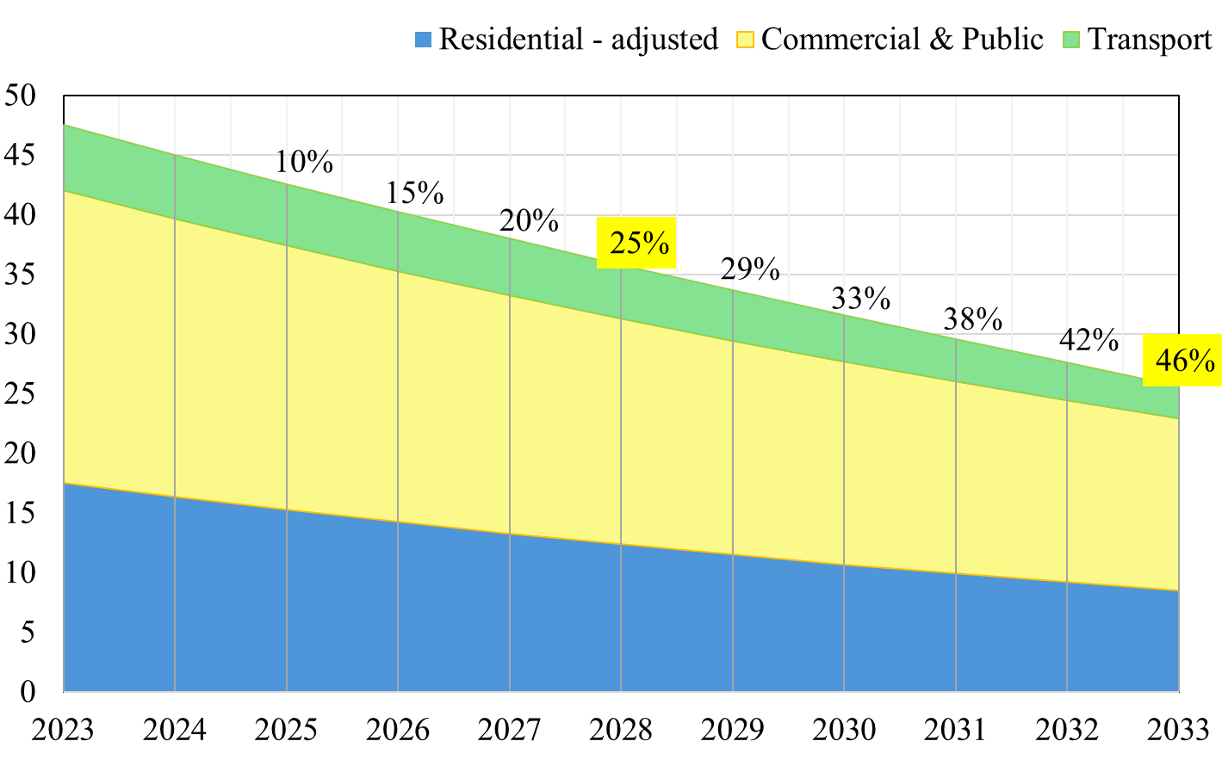
Athboy SEC Carbon Reduction Projection – All Sectors (2023-2033)
Athboy EMP - 2033 CO₂ Reduction Target
Notes:
Option 2

Slide 23
Key Takeaways
Every energy saving & carbon reduction measure is valuable
Encourage homeowners to consider developing their own 5 or 10-year plan to reduce energy and carbon for their home
Business owners and public building managers need to buy into the Energy Master Plan goals for Athboy
Encourage business owners and public building managers should report on annual energy use and conduct energy audits. Also develop a 5-year energy and CO₂ reduction plan for their businesses
Engage directly with One Stop Shop providers if proceeding with deep retrofits

